Slide 1
Biological Modeling of Neural Networks:
Week 11 – Continuum models –Part 1: Transients
11.1 Transients
- sharp or slow
11.2 Spatial continuum
- model connectivity
- cortical connectivity
11.3 Solution types
- uniform solution
- bump solution
11.4. Perception
11.5. Head direction cells
Week 11 – Continuum models:
Cortical fields and perception
Wulfram Gerstner
EPFL, Lausanne, Switzerland
Notes:
Lecture 11: Quiz after 35 minutes, then spatial continuum;
blackboard calculation before the break to the point before the continuum limit is taken:
Second lecture: Exercise 1 at 10:30-10:45
Third lecture : Exercise 2 at 11:18-11:30
Stopped at 11:45

Slide 2
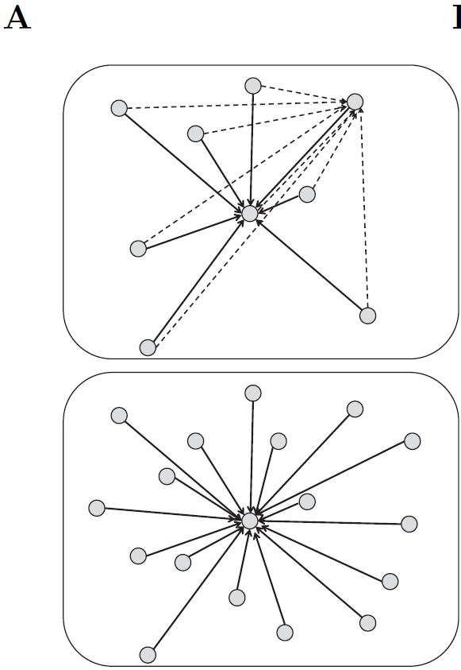
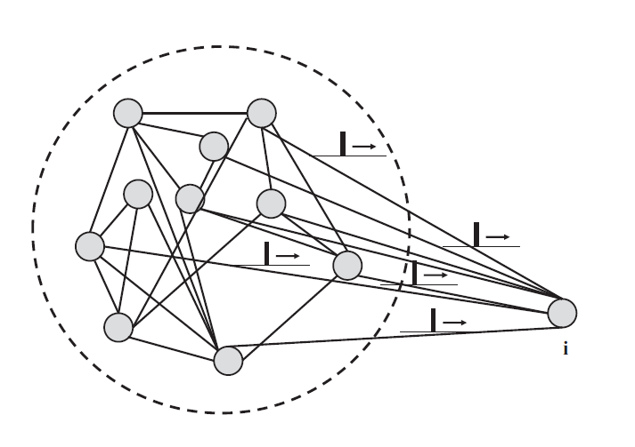
review from Week 10-part 3: mean-field arguments
Single population
full connectivity
All neurons receive the same
total input current (‘mean field’)

Slide 3
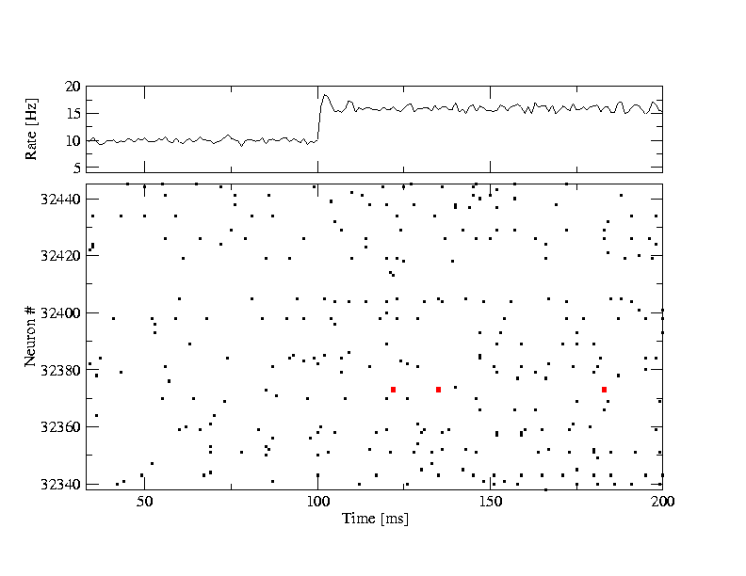
Review from Week 10: stationary state/asynchronous activity
Homogeneous network
All neurons are identical,
Single neuron rate = population rate
A(t)= A0= const
Single neuron
frequency (single neuron)

Slide 4
Week 10-part 3: mean-field arguments
All neurons receive the same total input current (‘mean field’)
fully
connected
Index i disappears
All spikes, all neurons

Slide 5
Week 11-part 1: Transients in a population of uncoupled neurons
t
Blackboard:
h(t)
?
I(t)
Students:
Which would you choose?
h(t)
potential
population
activity
A(t)
A(t)
A(t)
A(t)

Slide 6
Week 11-part 1: Transients in a population of neurons
Population
- 50 000 neurons
- 20 percent inhibitory
- randomly connected
Connections
4000 external
4000 within excitatory
1000 within inhibitory
input
-low rate
-high rate

Slide 7
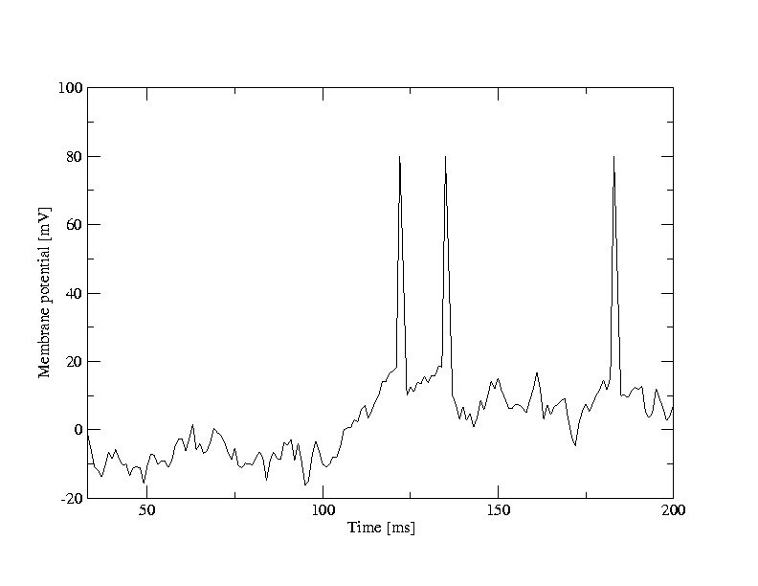
Week 11-part 1: Transients in a population of neurons
A [Hz]
10
32440
Neuron #
input
-low rate
-high rate
32340
time [ms]
200
50
100
100
Neuron # 32374
u [mV]
Population
- 50 000 neurons
- 20 percent inhibitory
- randomly connected
0
50
100
time [ms]
200

Slide 8
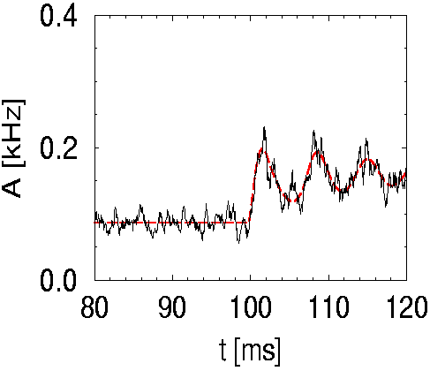
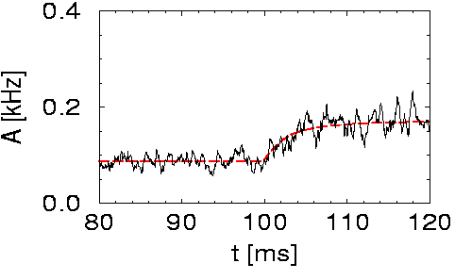
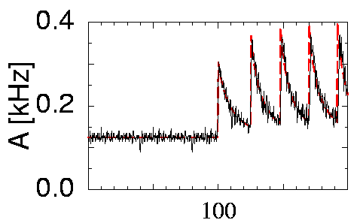
Week 11-part 1: Theory of transients for escape noise models
uncoupled population
(escape noise/fast noise)
(escape noise/fast noise)
low noise
low noise
high noise
noise-free
I(t)
I(t)
h(t)
h(t)
fast transient
slow transient
But transient oscillations

Slide 9
Week 11-part 1: High-noise activity equation
noise model A
blackboard
(escape noise/fast noise)
In the limit of high noise,
high noise
Population activity
Membrane potential caused by input
I(t)
h(t)
slow transient

Slide 10
Week 11-part 1: High-noise activity equation
noise model A
Population activity
(escape noise/fast noise)
high noise
Membrane potential caused by input
I(t)
h(t)
slow transient
1 population = 1 differential equation

Slide 11
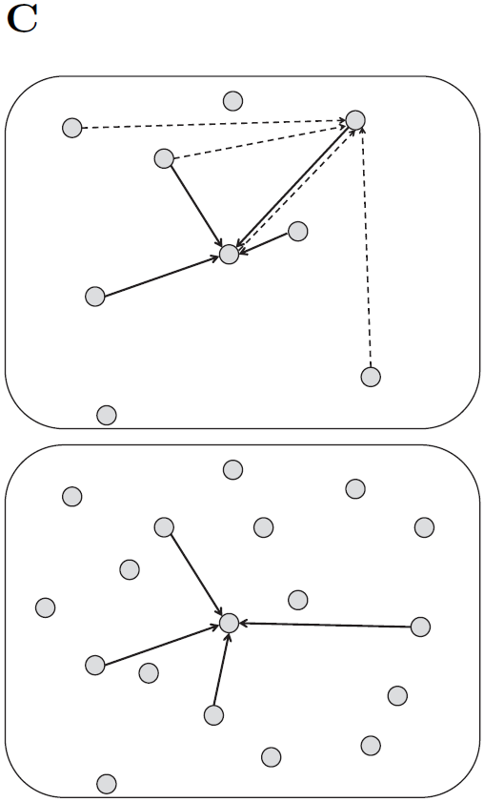
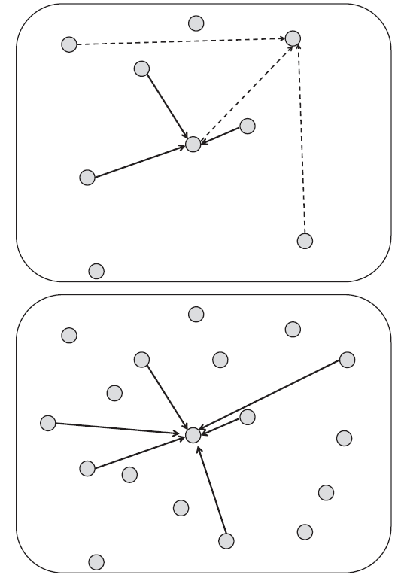
Week 10-part 2: mean-field also works for random coupling
full connectivity
random: prob p fixed
random: number K
of inputs fixed
Image: Gerstner et al.
Neuronal Dynamics (2014)

Slide 12
Quiz 1, now
Population equations
[ ] A single cortical model population can exhibit transient oscillations
[ ] Transients are always sharp
[ ] Transients are always slow
[ ] in a certain limit transients can be slow
[ ] An escape noise model in the high-noise limit
has transients which are always slow
[ ] A single population described by a
single first-order differential equation (no integrals/no delays)
can exhibit transient oscillations

Slide 13
Biological Modeling of Neural Networks:
Week 11 – part 2 :
11.1 Transients
- sharp or slow
11.2 Spatial continuum
- from multiple to continuous populations
- cortical connectivity
11.3 Solution types
- uniform solution
- bump solution
11.4. Perception
11.5. Head direction cells
Week 11 – Continuum models:
Cortical fields and perception
Wulfram Gerstner
EPFL, Lausanne, Switzerland
Notes:
Lecture 11:

Slide 14
Week 11-part 2: multiple populations → continuum
Blackboard

Slide 15
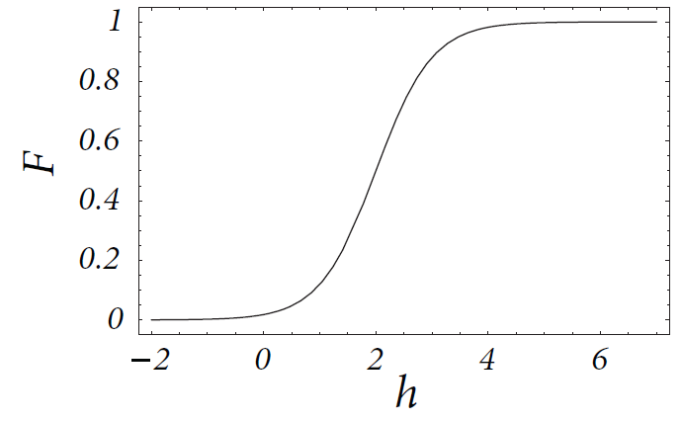
Week 11-part 2: Field equation (continuum model)
Population activity
Membrane potential caused by input
1 field = 1 integro-differential equation

Slide 16
Exercise 1.1 now (stationary solution)
Consider a continuum model,
Find analytical solutions:
- spatially uniform solution A(x,t)= A0
Next lecture at
10:45
If done: start with Exercise 1.2 now (spatial stability)
Notes:
Start exercise at 10:30

Slide 17
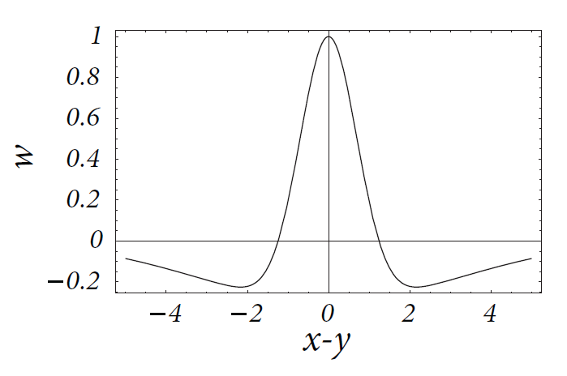
Week 11-part 2: coupling across continuum
x
y
Mexican hat

Slide 18
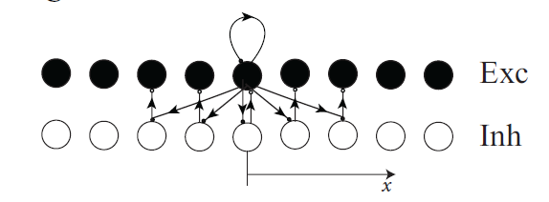
Week 11-part 2: cortical coupling

Slide 19
Biological Modeling of Neural Networks:
Week 11 – part 3 :
11.1 Transients
- sharp or slow
11.2 Spatial continuum
- from multiple to continuous populations
- cortical connectivity
11.3 Solution types
- uniform solution
- bump solution
11.4. Perception
11.5. Head direction cells
Week 11 – Continuum models:
Cortical fields and perception
Wulfram Gerstner
EPFL, Lausanne, Switzerland
Notes:
Lecture 11:

Slide 20
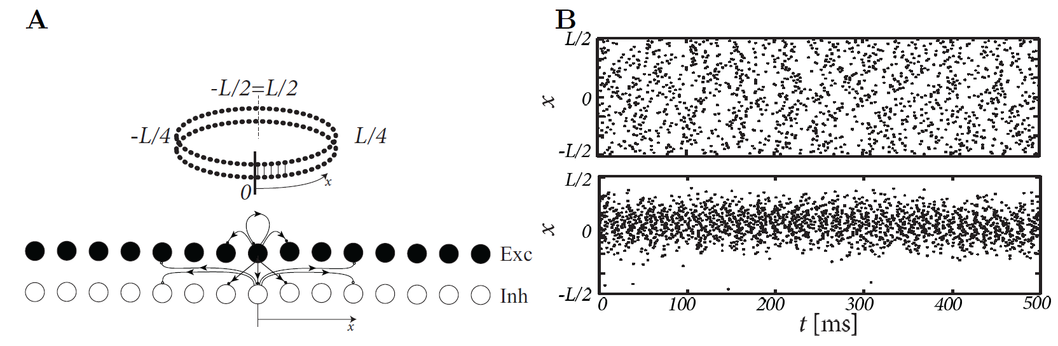
Week 11-part 3: Solution types (ring model)
Coupling:
Input-driven regime
Bump attractor regime

Slide 21
Week 11-part 3: Solution types: input driven regime
Field Equations:
Wilson and Cowan, 1972
I. Edge enhancement
A(x)
Weaker lateral connectivity
Possible interpretation
of visual cortex cells:
(see final part this week)
0
I(x)

Slide 22
Week 11-part 3: Solution types: bump solution
Field Equations:
Wilson and Cowan, 1972
II: Bump formation:
activity profile in the absence of input
A
strong lateral connectivity
Possible interpretation
of head direction cells:
→ (see later today)
0
Notes:
I stopped here the end of the second lecture (at 11:00)

Slide 23
Exercise 2.1+2.2 now (stationary bump solution)
Next lecture at
11:28
Consider a continuum model,
Find analytically the bump solutions
w(x-y)
Notes:
Start here at 11:18

Slide 24
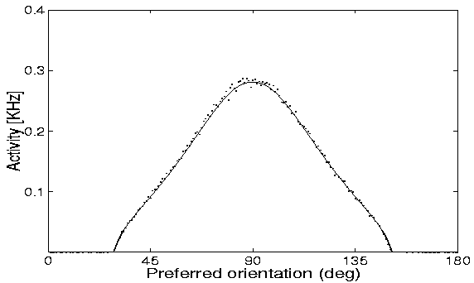
Week 11-part 3: Solution types: bump solution
Spiridon&Gerstner
Comparison simulation of neurons
and macroscopic field equation
Continuum: stationary profile
See: Chapter 9, book:
Spiking Neuron Models,
W. Gerstner and W. Kistler, 2002

Slide 25
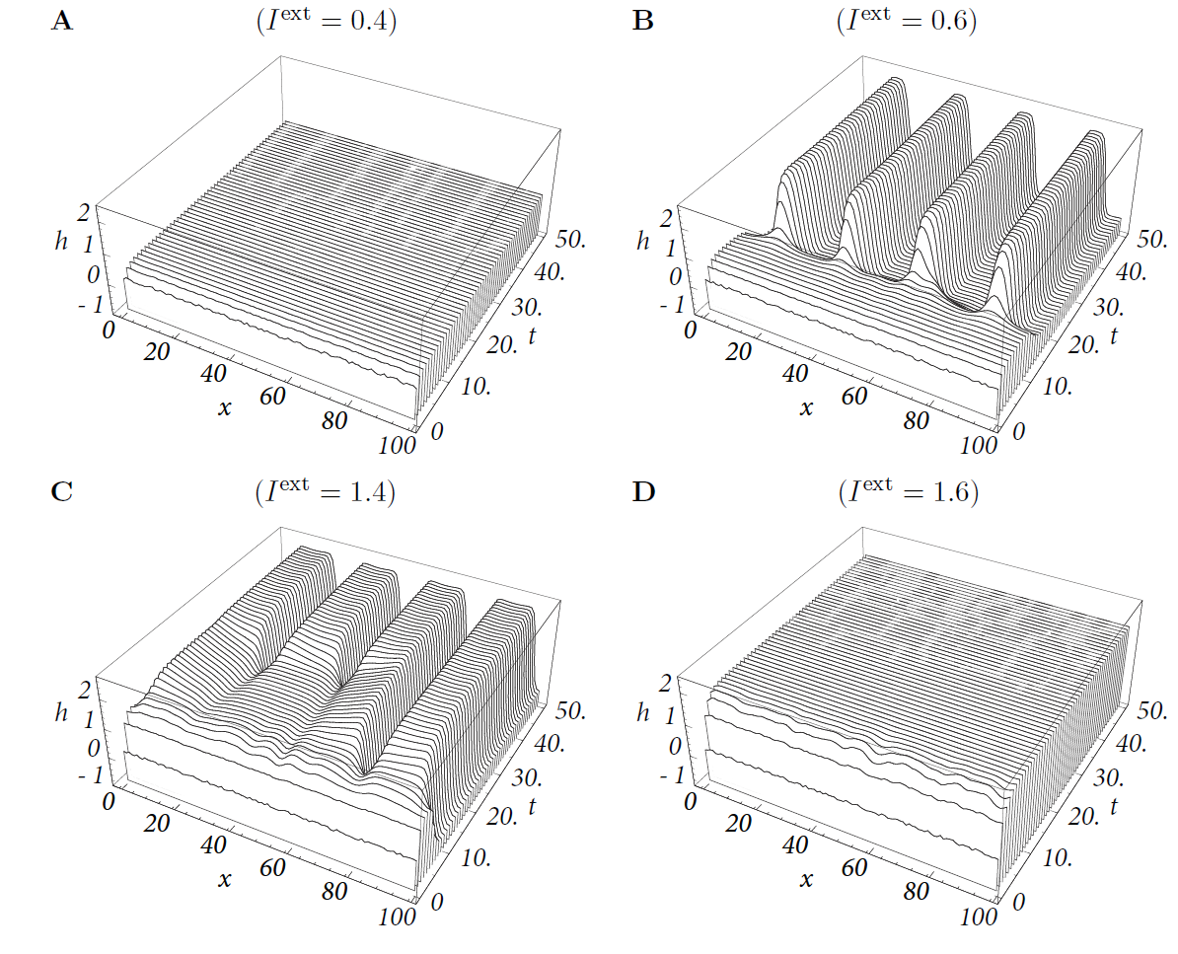
Week 11-part 3: Solution types (continuum model)
time

Slide 26
Biological Modeling of Neural Networks:
Week 11 – part 4:
11.1 Transients
- sharp or slow
11.2 Spatial continuum
- model connectivity
- cortical connectivity
11.3 Solution types
- uniform solution
- bump solution
11.4. Perception
11.5. Head direction cells
Week 11 – Continuum models:
Cortical fields and perception
Wulfram Gerstner
EPFL, Lausanne, Switzerland
Notes:
Lecture 11:

Slide 27
Week 11-part 5: uniform/input driven solution
Field Equations:
Wilson and Cowan, 1972
Basic phenomenology
I. Edge enhancement
A(x)
Weaker lateral connectivity
Possible interpretation
of visual cortex cells:
contrast enhancement in
- orientation
- location
0
I(x)

Slide 28
Continuum models: grid illusion

Slide 29
Continuum models: Mach Bands

Slide 30
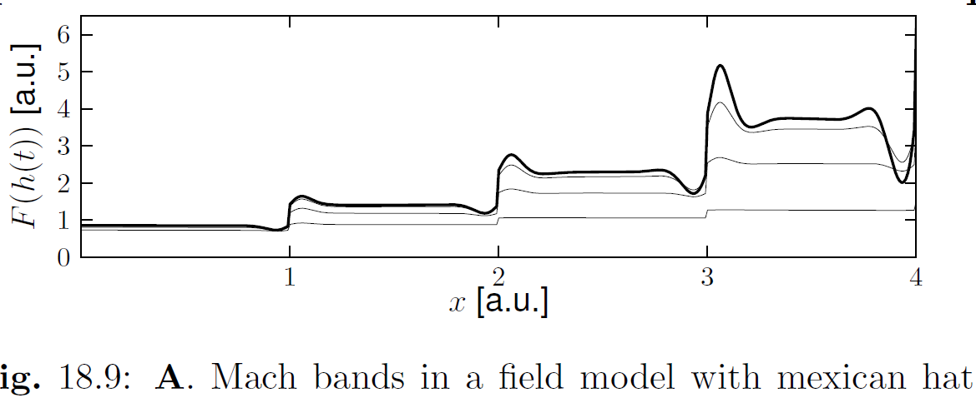
Week 11-part 4: Field models and Perception

Slide 31
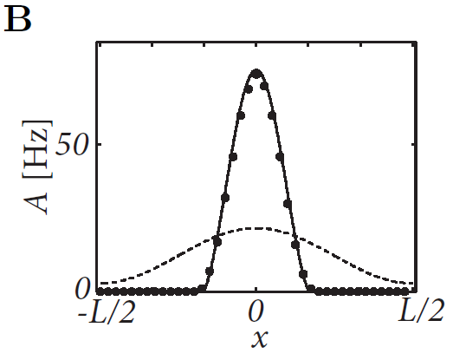
Week 11-part 4: Field models and Perception

Slide 32
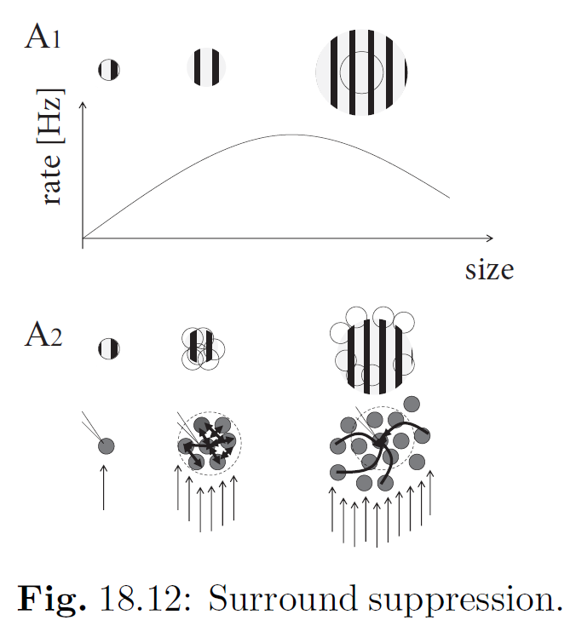
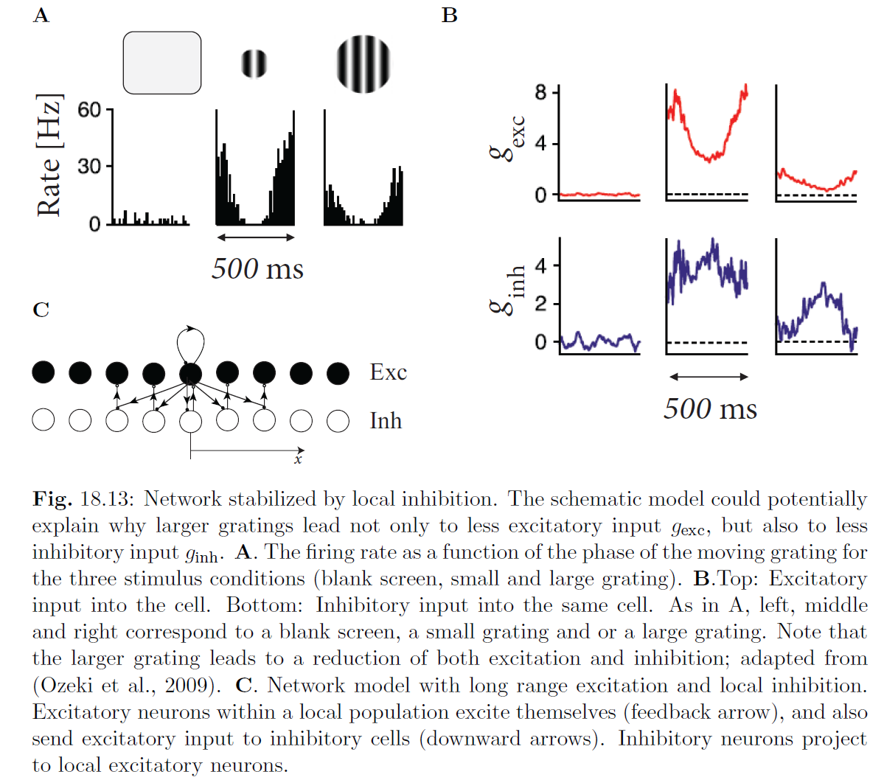
Week 11-part 4: Field models and Perception

Slide 33
Biological Modeling of Neural Networks:
Week 11 – part 5:
11.1 Transients
- sharp or slow
11.2 Spatial continuum
- model connectivity
- cortical connectivity
11.3 Solution types
- uniform solution
- bump solution
11.4. Perception
11.5. Head direction cells
Week 11 – Continuum models:
Cortical fields and perception
Wulfram Gerstner
EPFL, Lausanne, Switzerland
Notes:
Lecture 11:

Slide 34
Week 11-part 5: Bump solution
Basic phenomenology
II: Bump formation
A
strong lateral connectivity
Possible interpretation
of head direction cells:
always some cells active
→ indicate current orientation
0

Slide 35
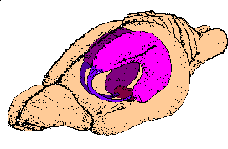
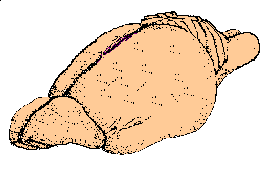
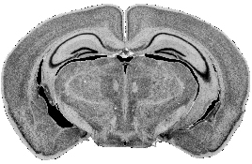
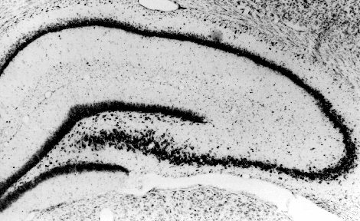
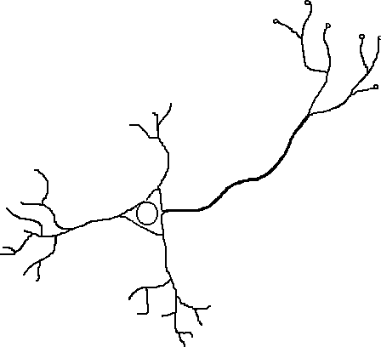
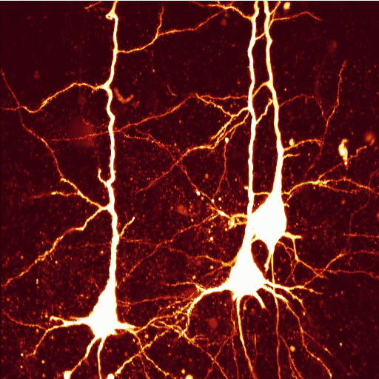
Week 11-part 5: Hippocampal place cells
CA1
CA3
rat brain
DG
Place fields
electrode
synapses
axon
soma
dendrites
pyramidal cells

Slide 36
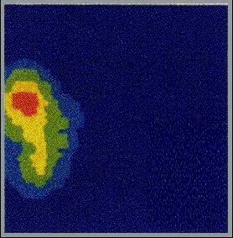

Week 11-part 5: Hippocampal place cells
Main property: encoding the animal’s location
place field

Slide 37
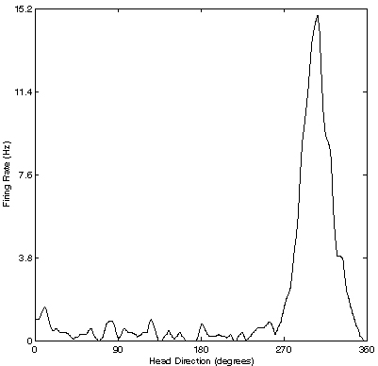
Week 11-part 5: Head direction cells
Main property: encoding the animal ’s heading
r (θ)
i
Φ
θ
θ
θ
i
Preferred firing direction

Slide 38
Week 11-part 5: Head direction cells
Main property: encoding the animal ’s allocentric heading
90
r (θ)
i
180
0
300
270
θ
θ
i
Preferred firing direction

Slide 39
Week 11-part 5: Head direction cells

Slide 40
Week 11-Continuum models
11.1 Transients
- sharp or slow
11.2 Spatial continuum
- model connectivity
- cortical connectivity
11.3 Solution types
- uniform solution
- bump solution
11.4. Perception
11.5. Head direction cells
The END
Notes:
Lecture 11:

